Slide 1
INSURANCE POLICY ENDORSEMENT BASED ON ANDROID SYSTEM
Team members:
1.Jenifer Nancy.S
2.Kavithanjali.V
3.Apurvaa.S
Industry Mentor
Mr.Arun Kumar
Faculty Guide:
Mrs.SIVARANJANI.S
Department of CSE, KGiSL Institute of Technology, Coimbatore

Slide 2
Abstract An insurance endorsement is an amendment to an existing insurance contract, for changing the terms or scope of the original policy. An insurance endorsement may be used to add, delete, exclude or otherwise alter coverage . Insurance endorsement App is a product – oriented software covering every business area in Insurance and provides its end users to manage their policy on-the-go without spending separate time for optimizing the policy contents.
Department of CSE, KGiSL Institute of Technology, Coimbatore

Slide 3
Area Introduction-Existing system
For endorsement in the existing system needs each time login of user to view and edit the policy content.
The existing system require person to spend lot of time with computer system to fill up the forms.
Department of CSE, KGiSL Institute of Technology, Coimbatore

Slide 4
Proposed System
Proposed System is to implement latest android cellular technology in making the system still more secure, efficient and effective, for the purpose of insurance policy endorsement.
Requirement of onetime user login
Manage multiple policy at the same time
Manage on-the-go
The payment bill for the endorsement will be generated as a PDF file and it can be downloaded or shared.
Department of CSE, KGiSL Institute of Technology, Coimbatore

Slide 5
Proposed System
Advantages over existing methods
The system is planned to be built using Android App Technology with Java and NoSQL as database.
NoSQL databases are more scalable and provide superior performance, and their data model addresses several shortcomings of the relational model.
Notifications will be sent to the user regarding the due date for the renewal of their endorsement

Slide 6
Future Enhancements
The application can be made both online and offline application.
Renewal alerts can be sent to the user.
Fingerprint authentication can be added to secure the user account.

Slide 7
Literature Review
Drawbacks of existing methods
Need for computer systems in large scale and user experience in computer systems.
Depends completely on search engine's help.
Doesn't have high processing speed
References
www.icicilombard.com
www.insurance.com
Department of CSE, KGiSL Institute of Technology, Coimbatore

Slide 8
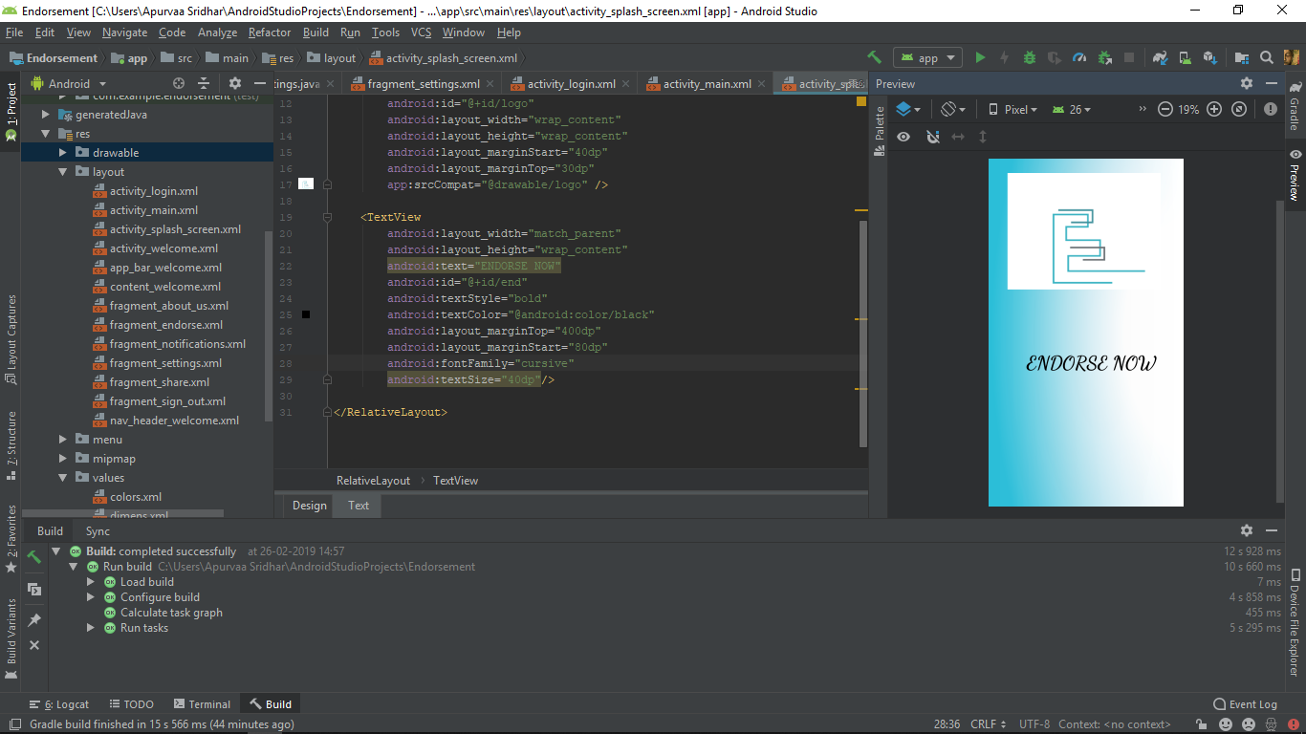
Splash Screen:
The splash screen is used at the beginning of any android application.
It lasts for 3-4 seconds
After the specified time, the screen will redirect to the login page or the registration page.

Slide 9
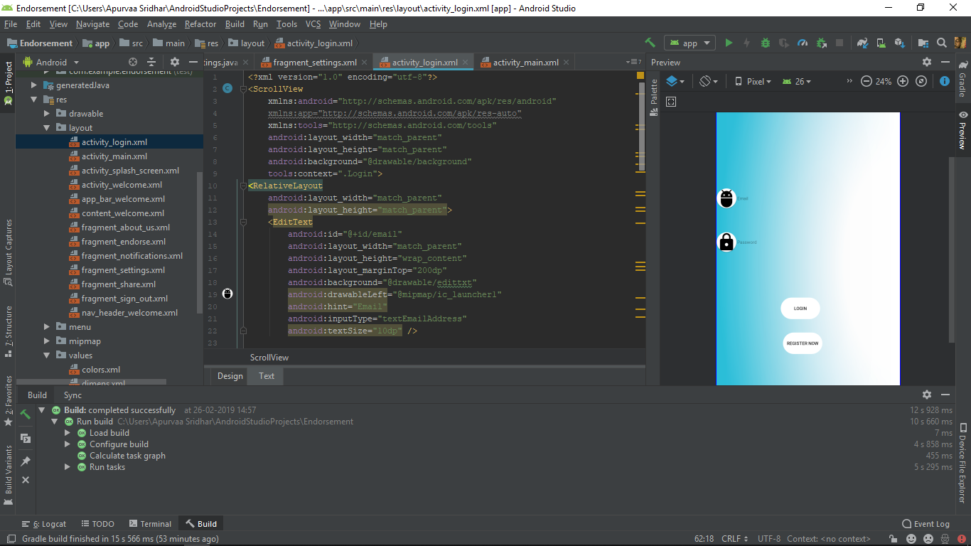
Login Screen:

Slide 10
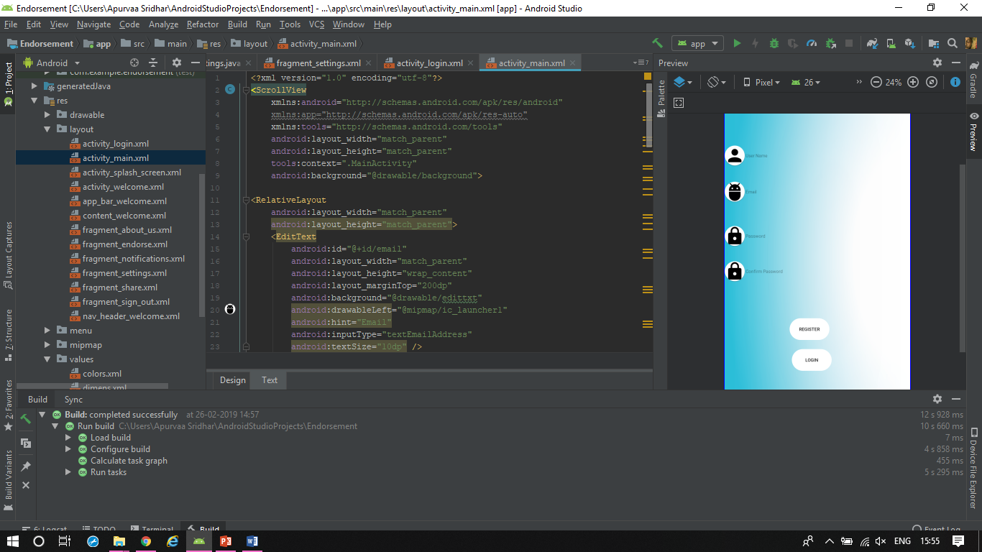
Register Screen:
The user who is using the application for the first time, registers by entering the User name, Email, password and confirming the password.
The database used here is Shared Preferences.

Slide 11
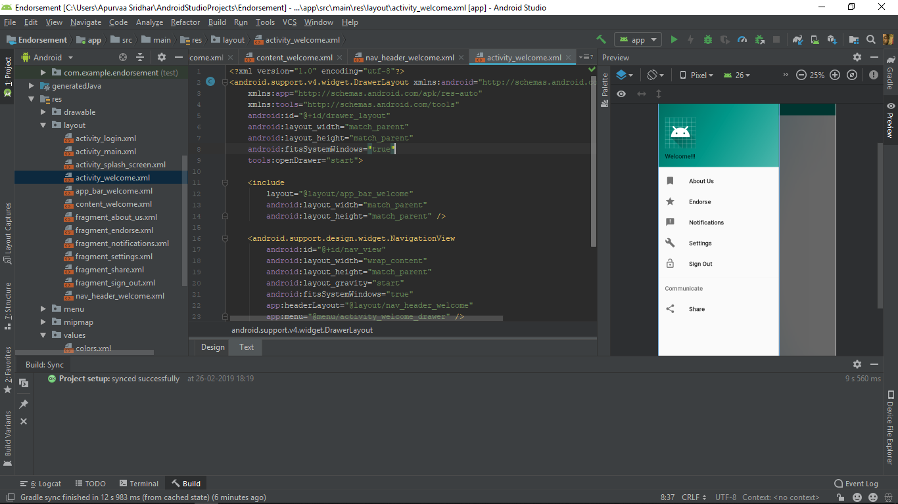
Navigation Drawer slide:

Slide 12
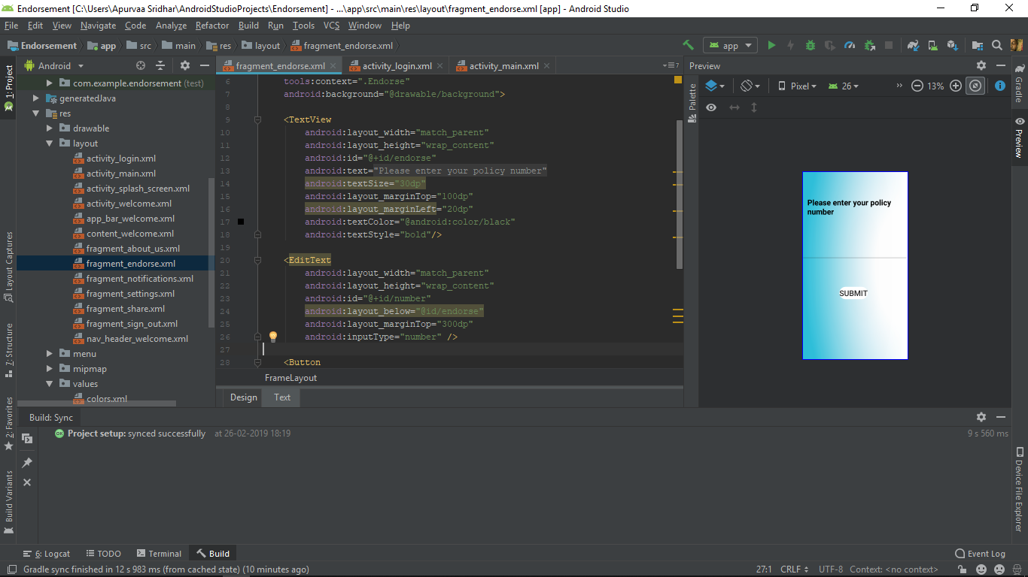
Entering the policy number:

Slide 13
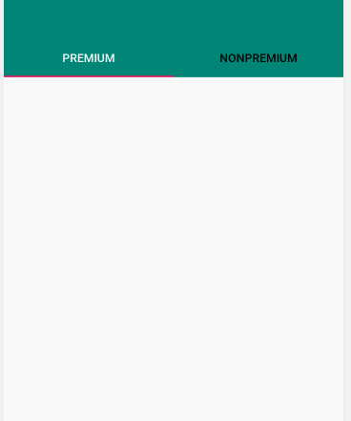
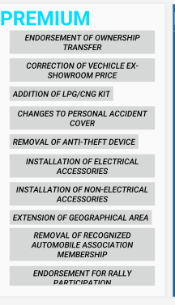
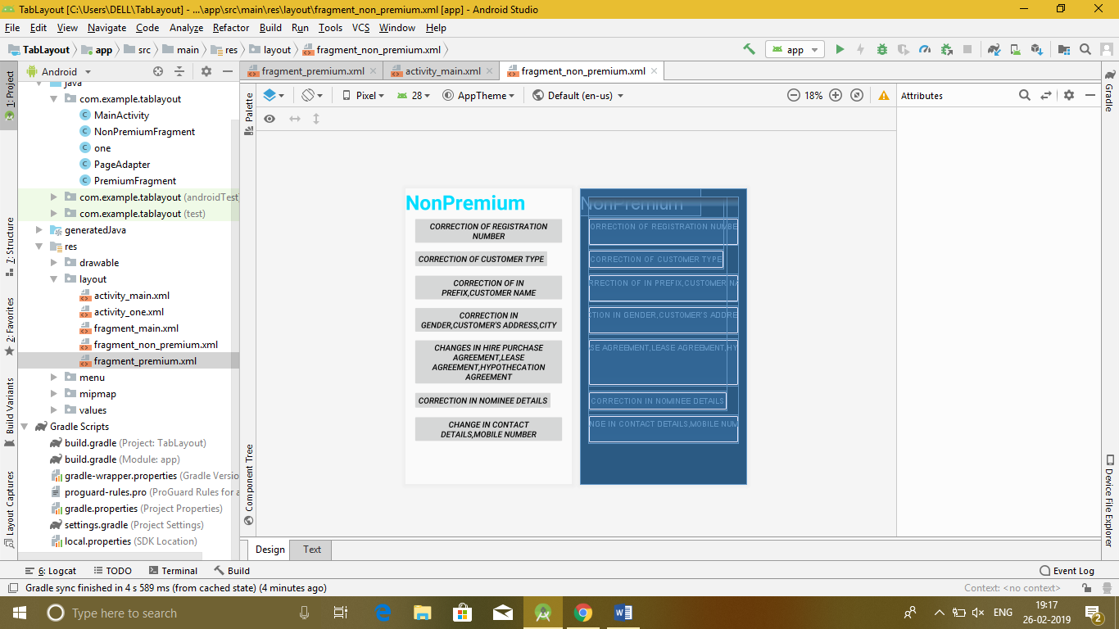
Selecting the type of Endorsement:

Slide 14
MODULE SPLIT-UP
MODULE-1:
Creation of login and registration form with Shared Preferences as database.
MODULE-2:
Creation of the policy details database using NoSQL.
MODULE-3:
Selection of the type of Endorsement with filling up the forms.
MODULE-4:
Calculation of the amount for the Endorsement and proceeding for the payment.

Slide 15
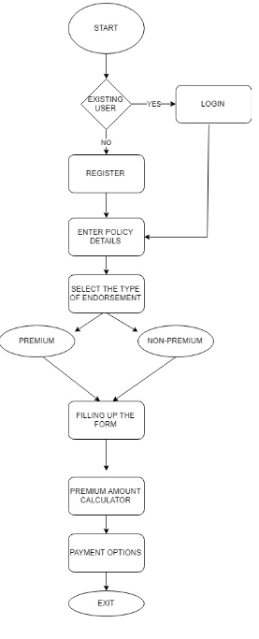
Flow chart

Slide 16
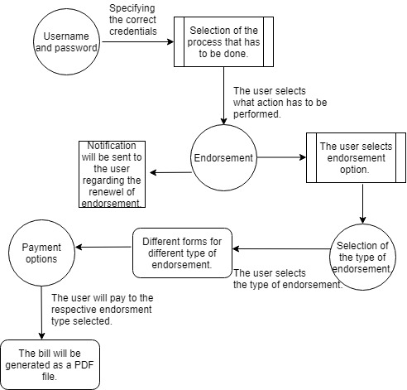
DATA-FLOW DIAGRAM

Slide 17
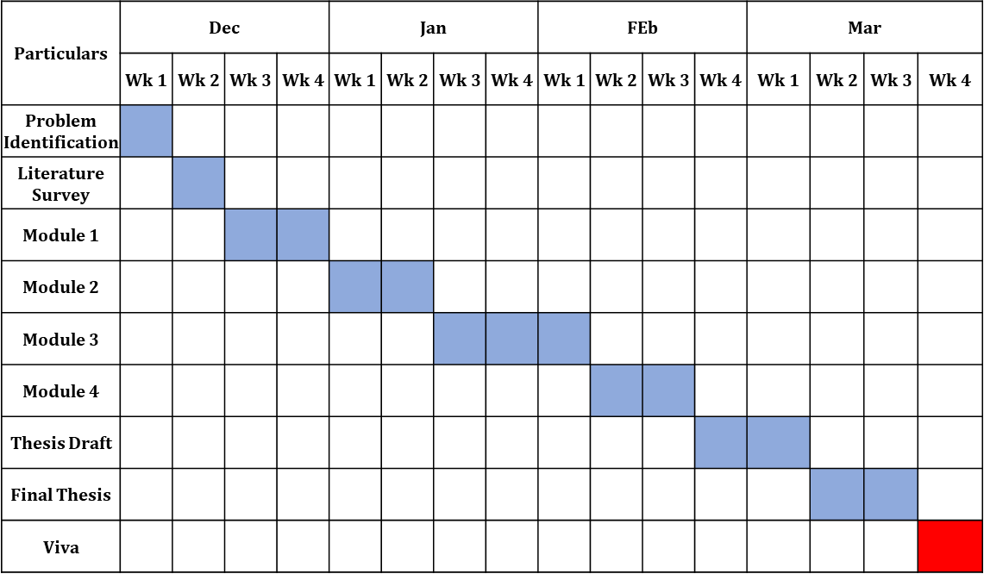
Project Planner / Timeline chart)

Slide 18
THANK YOU

